Slide 1
Ethiopia HIV Diagnostic Quality Assurance Framework
RT-CQI Best Practices Workshop For Western Hemisphere
August 26-30, Panama

Slide 2
Presentation Outline
Introduction
HIV Diagnostic Quality Assurance Framework
Strategy Used for Framework Development
Implementation Strategies
Implementation Experience
Challenges
Lessons Learned
Way Forward

Slide 3
Introduction
HIV Testing Services in Ethiopia
Ethiopia is getting closer to HIV epidemic control & is implementing targeted HIV testing following the three-test strategy recommended for low prevalence settings
Targeted are high risk individuals and key population groups
HIV testing and counseling services are provided at:
Healthcare facilities(OPDs, In-patients, VCT, PMTCT, TB & other clinics
Community level (workplace, mobile outreaches and home-based HTS).
Directly assisted or unassisted HIV self-testing

Slide 4
Introduction…cont’d
HIV Testing Services in Ethiopia
Healthcare facility laboratories provide complete HIV testing services and oversee the implementation of QA measures and monitor testing performance at different Testing Points.
Generally provide the 2nd & 3rd tests for all Testing Points
Conduct Confirmatory Re-testing prior to initiation of ART
Screening tests are generally conducted by trained nurses or other health workers

Slide 5
Introduction…cont’d
The Ethiopian Public health Institute (EPHI) is the technical arm of the MOH and is nationally mandated to:
Lead, conduct, and coordinate the prevention and control of public health emergency activities (Public Health Emergency Management System);
Build the capacity of health laboratories, provide referral laboratory testing services for public health emergency management, healthcare service; and undertake reference testing;
Undertake researches on priority public health and nutritional problems, programs and strategies;
Establish and manage national health data management and analytics center by gathering health and health-related data from various sources.

Slide 6
HIV Diagnostic Quality Assurance Framework
The Ethiopia HIV Diagnostic Quality Assurance Framework is built on the following pillars:
Policy Engagement
Ensuring alignment with and responsiveness to the national HIV rapid testing policy
Engagement of stakeholders and advocacy for resource allocation
Human Resource Development
Training and certification of tester’s, auditors, etc.
Mentoring, coaching via supportive supervisions
Creation of functional networks (testers, auditors, etc.)
Testing Site Certification
Ensuring site readiness & fulfillment of SPI-RT requirements
Regular supportive supervision and assessments

Slide 7
HIV Diagnostic Quality Assurance…cont’d
IQC Practices & Participation in Proficiency Testing Scheme
Ensuring routine IQC practices at all testing points
Monitoring performance of testing points and expanding coverage of PT participation using DTS
Analysis of data for timely corrective actions and use for CQI
Management of Documents and Records
Standardized HTC Register
SOPs, Job aids, QC and PT records, current algorithm, etc.
Lot Testing and Post Market Surveillance
Strengthening national capacity for verification of new test kit lots and post distribution QC undertakings
Procurement and Supply Management
Ensure availability of adequate commodities at all times

Slide 8
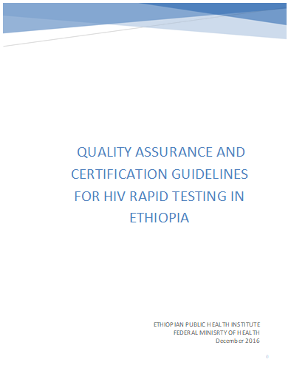
HIV Diagnostic Quality Assurance…cont’d

Slide 9
Strategy Used for Framework Development
Establishment of NTWG comprising subject matter experts
Development of draft document
Review and enrichment of document at consultative workshops in the presence of all stakeholders and partners
Document endorsement & approval by MoH/EPHI
Publication and distribution

Slide 10
Implementation Strategies
Establishment of a national coordination team
Plan development with the involvement of all stakeholders and partners
Definition of roles and responsibilities of key players at different levels (implementation arrangements)
Mobilization of the required resources
Phased approach implementation-piloting, M&E, and stepwise expansion

Slide 11
Implementation Experience
Comprehensive HIV QA and certification Guidelines developed
Standardized HIV Rapid Test Logbook prepared and distributed
SPI-RT and M&E checklists customized
Training materials standardized for both TOT and rollout trainings
Forms and tools for capturing IQC, and PT data prepared and distributed
Training (TOT and basic) on Algorithm & Testing conducted

Slide 12
Implementation Experience…cont’d
Capacity built for regular production of DTS PT panel at national and regional levels
Necessary preparations made for the implementation of tester and site certification programs
Regular monitoring and evaluation conducted
Effective use of laboratory data for RT-CQI excercised

Slide 13
Challenges
Inconsistent supply chain of testing kits
Frequent turnover of trained staff
Shortages of supplies for the production of DTS PT panels
Inadequate adherence to key QA measures
Lack of consistency in lot verification & Post Market Surveillance (PMS) activities
Unable to implement tester and testing site certification programs at all levels

Slide 14
Lessons Learned
The importance of properly planned and managed stepwise implementation with close M&E, data management and use for continuous quality improvement actions
Promoting involvement and engagement of all stakeholders & partners at all levels of implementation has proven to be key for success
Significant improvement in key performance indicators for quality laboratory diagnosis of HIV
Notes:
(IQC practices, EQA participation & performance, supply chain management, documents and records, data availability, quality and use, testing facility infrastructure & space, competency of testers, etc

Slide 15
Way Forward
Further improve, strengthen and sustain all achievements
Improve the supply chain management system of commodities (test kits + supplies for DTS PT)
Improve national capacity for sustainable implementation of lot verification and PMS activities
Systematically implement Certification Programs for Testers and Sites

Slide 16
Thank you!

